Slide 1
IS303 Final Project
By Lydia Mayenge

Slide 2
Efficiency goal violation
The Hacker News website violates several principles of efficient interactive design. The core goal of efficiency is enabling users to complete tasks as quickly as possible once they learn the system. Efficiency tests if users can be productive once learning the system (Hamidi 2024). The site’s lack of clear navigation, filtering options, and personalization not only does not adhere to most users’ mental model but it slows down task completion. It's difficult to find relevant articles due to the long lists of plain text with no useful filters, intuitive menu structure nor information architecture. Users must scroll endless amounts or search ineffectively. There's also no way to switch between bookmarked items easily for multitasking. This slows users down.
The site offers no options for organizing content productively across visits either. Without any folders, lists, or tag features, users feel like they start from scratch each time rather than continuing past work. Customization is missing too, so workflows can't match tasks/skills. All this "extra" effort undermines the goal of acting promptly on needed resources. A adjustable layout optimized for personal organization and shortcuts could boost how rapidly users complete and transition between content related activities.
While the community itself has value, the rigid design creates hurdles that sabotage taking full advantage once accustomed to finding information quickly. Some rework could resolve this disconnect between quick functioning and the actual presentation/features provided.
Notes:
See callouts and screenshots on the next page

Slide 3
Callouts & Screenshots

Slide 4
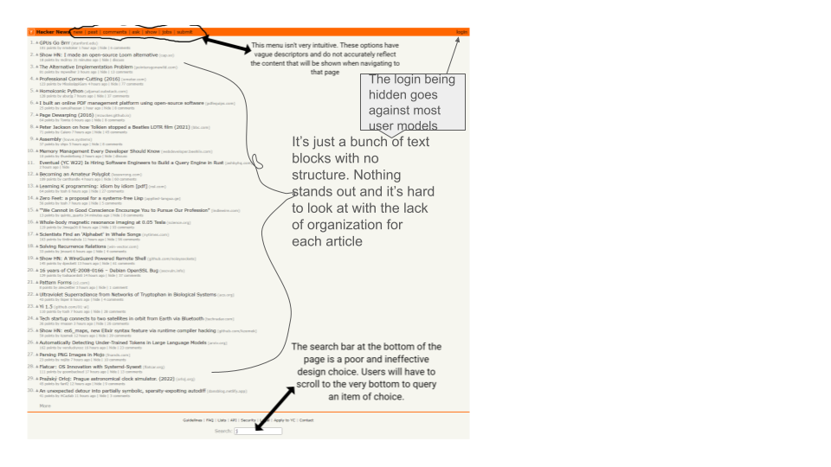
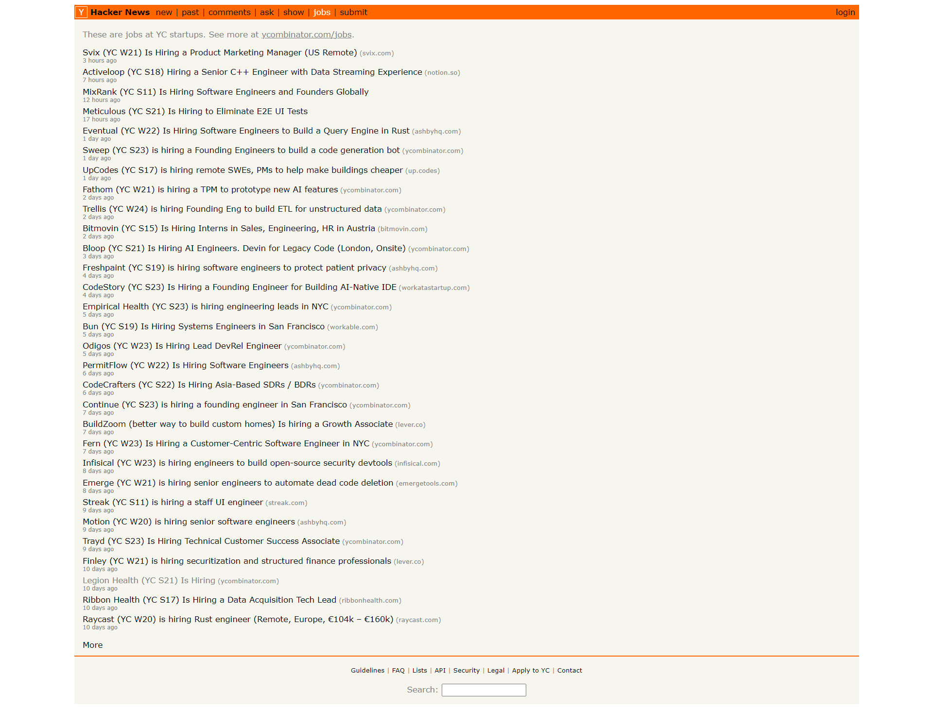
Main page
This site has no pictures. It’s plain, hard to read and quite an eyesore!
When clicked on, the more link at the bottom of the page will just display more text blocks. Would be better if there was more organization with the article results like google

Slide 5
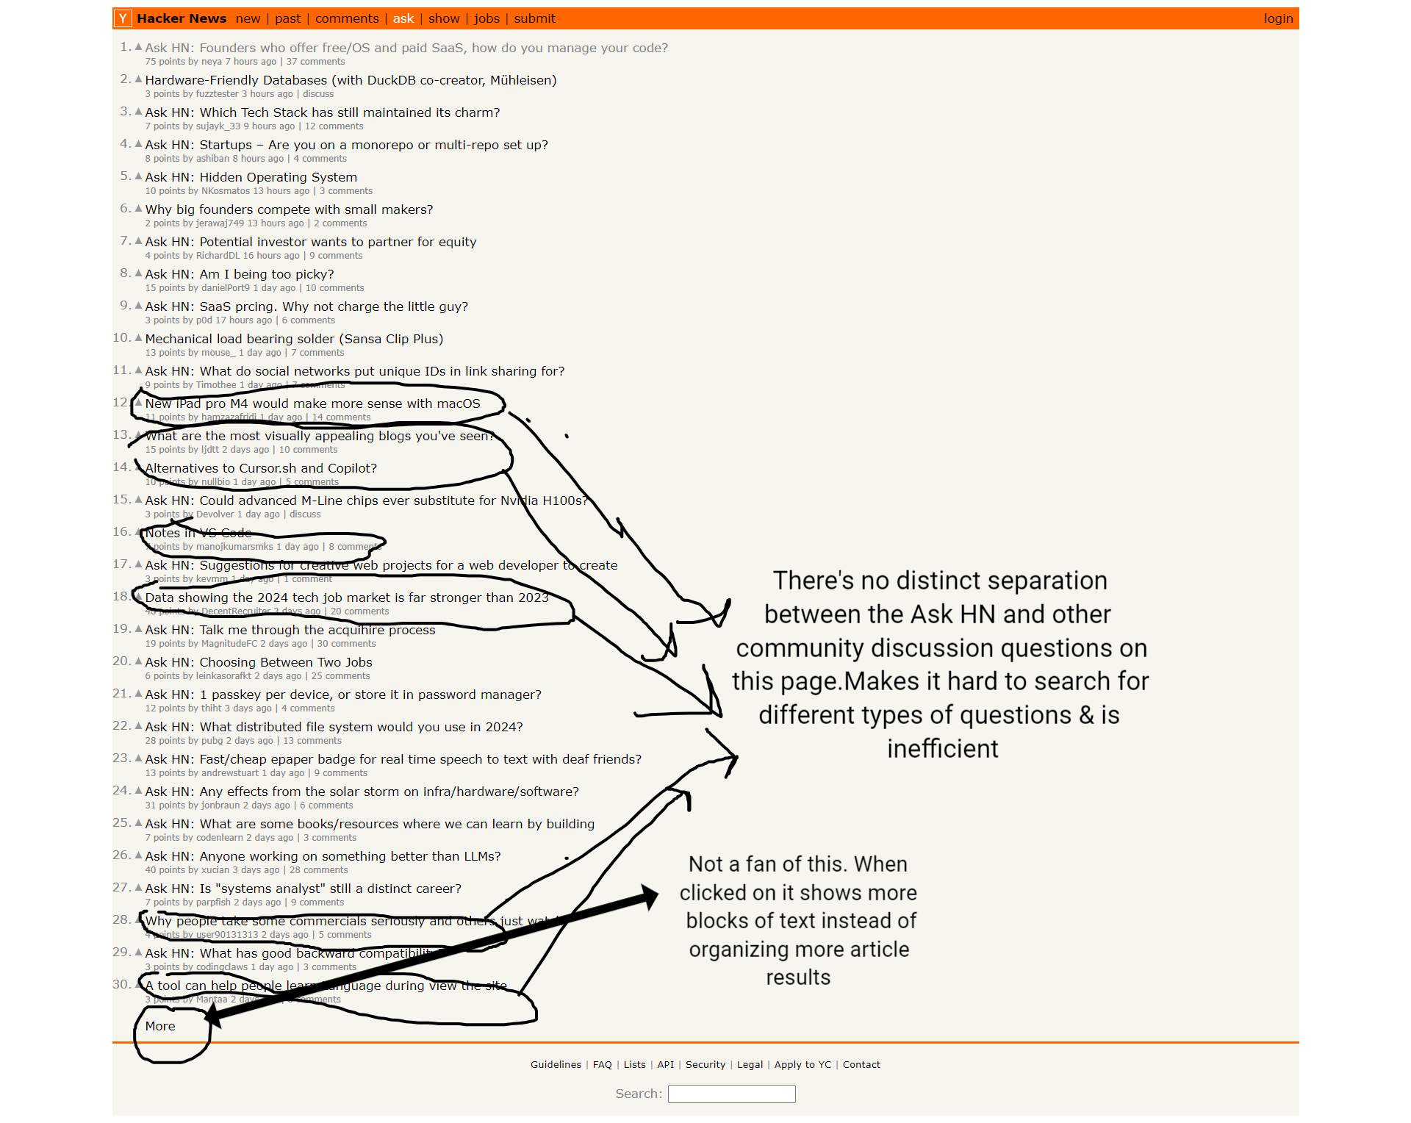
Second Page

Slide 6
Redesigns

Slide 7
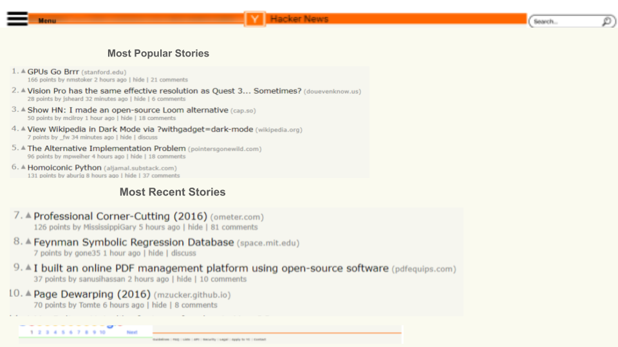

Login
Notes:
Homepage

Slide 8
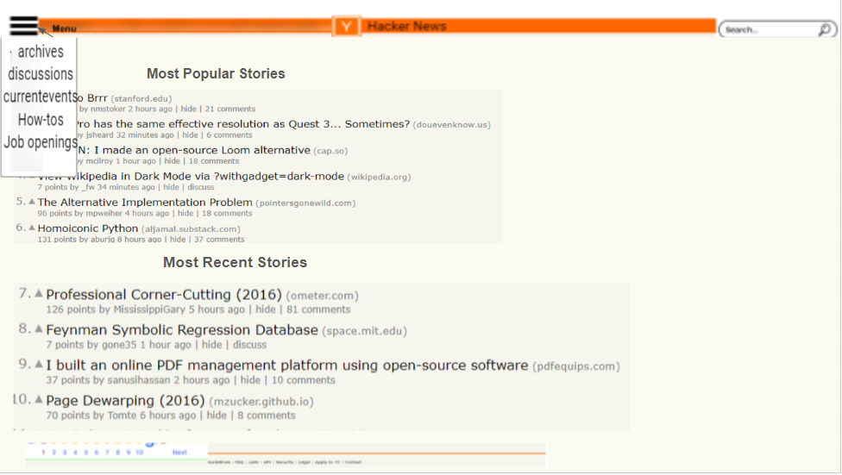
Login
Notes:
Homepage

Slide 9
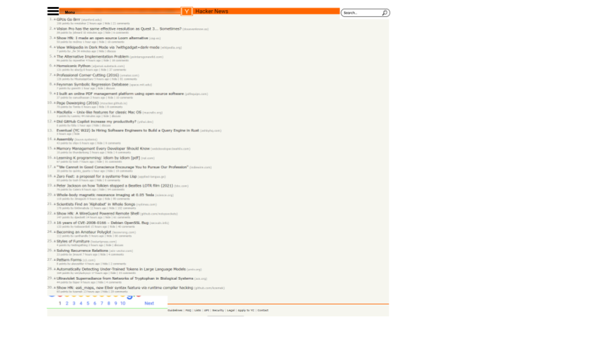
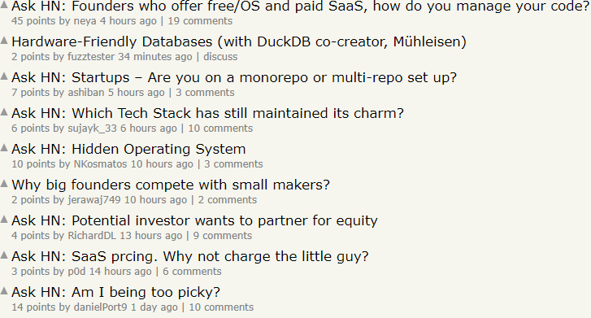
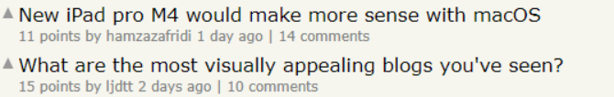

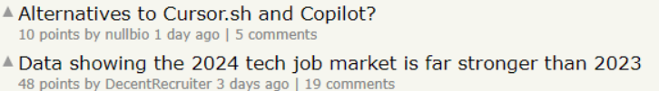
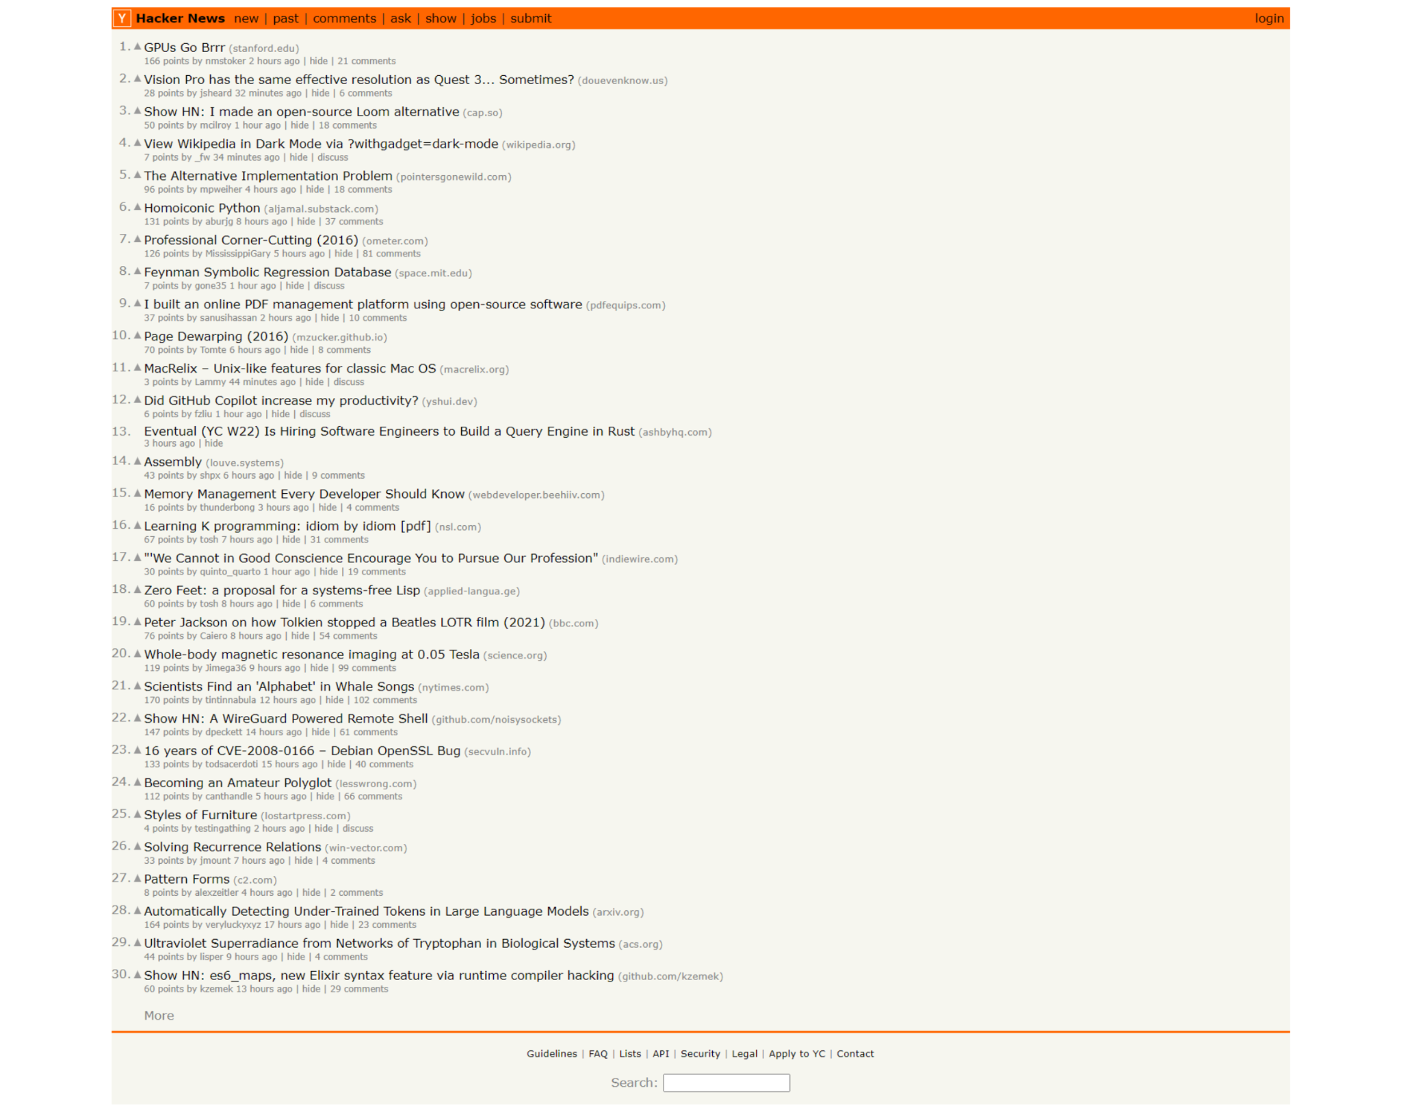
Login
Discussions
Ask HN
Community Discussions 💬
Show More Results
Have a question you don’t see? Click here to submit a question to the community!
Click here to see more on Ask HN
Notes:
‘Ask’ page

Slide 10
Login
Discussions
Ask HN
Community Discussions 💬
Show More Results
Have a question you don’t see? Click here to submit a question to the community!
Click here to see more on Ask HN
Notes:
‘Ask’ page

Slide 11
Login
Discussions
Ask HN
Community Discussions 💬
Show More Results
Have a question you don’t see? Click here to submit a question to the community!
Click here to see more on Ask HN
https://news.ycombinator.com/discussion/post-a-question
Notes:
‘Ask’ page

Slide 12
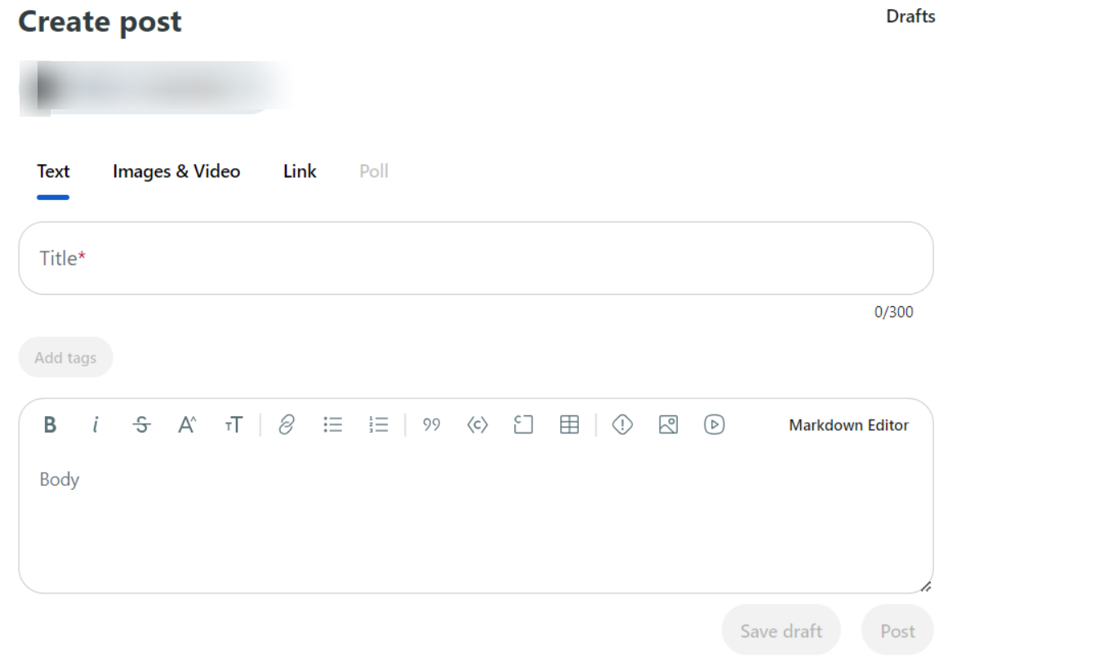
Login
Discussions
Notes:
‘Ask’ page -> created a new page on the ask page that allows users to post a question

Slide 13
Writeups

Slide 14
Rationale for Redesign choices hamburger menu (homepage)
One noticeable part of the website that does not meet the efficiency usability goal is the menu options.Visibility refers to the basic ID principle that the more visible a function is, the more likely users will know what to do next (Hamidi 2024). In the case of the menu options, their vague and unclear titles did not accurately represent the available navigation pages, leading to confusion and difficulty for users in understanding and finding the desired content efficiently. As a result, users have to use additional cognitive resources to decipher and interpret the menu options which can lead to frustration and hinder the overall user experience. This extra cognitive effort and additional user interactions directly compromised the efficiency goal. Instead of being able to immediately start completing important actions like navigating to other sections or finding relevant articles through search, users first had to determine where these critical elements were even located, slowing down their overall workflow and task completion speed. By not prominently showcasing the key functionality upfront per typical interface conventions, these hidden affordances created unnecessary friction and longer learnability curves for visitors
The poor visibility of the menu options violates the concept of good affordances. Affordances are the visual or functional cues that suggest how an element should be interacted with (Hamidi 2024). In this case, the menu options acted as hidden affordances because their vague labels did not provide clear indications of their function or purpose. This lack of clear affordances made it challenging for users to understand the available navigation choices and slowed down their ability to find relevant content efficiently. To address this issue, I implemented a hamburger menu. The hamburger icon itself serves as a recognizable affordance, indicating the presence of a menu. When clicked, the expanded menu presents clear and concise titles for each option. This redesign enhances the visibility of the menu options, reduces cognitive load, improves user comprehension, and ultimately contributes to achieving the efficiency usability goal.
Overall, my edesign enhances the efficiency usability goal by improving the visibility of menu options and providing clear affordances for navigation. By redesigning the website with a hamburger menu and clear titles for each option, the visibility of the menu was significantly improved. The hamburger icon itself serves as a recognizable affordance, indicating the presence of a menu. When clicked, the expanded menu presents clear and concise titles for each option, making it easier for users to comprehend the available navigation choices and navigate the site more efficiently. This enhanced visibility of the menu options reduces cognitive load, improves user comprehension, and ultimately contributes to achieving the efficiency usability goal. Users can easily understand the available choices and efficiently find the desired content, reducing cognitive load and enhancing the overall user experience.

Slide 15
Rationale for Grid & Alignment structure (Homepage)
The original grid structure and top-down alignment of the Hacker News homepage violated the usability concept of supporting user mental models. One of the key principles we learned about is designing according to how people naturally think about and interact with information. User mental model is defined as “ a set of beliefs people have of themselves, others, the environment, and the things with which they interact” (Hamidi 2024). In general, users tend to prioritize factors like recency, relevance and personalized preferences when scanning news-style content. However, the rigid hierarchy imposed by stacking all articles sequentially from the top did not take these common heuristics into account as you can see noted on slide 5 (Mayenge 2024). It prioritized the website's own organizational model over matching audiences' mental model. As a result, the layout contradicted common mental frameworks for topic-based scanning and assessment that emphasize things like clustering similarity and immediacy over fixed sequences. This disconnect between the presentation and typical user mindsets impeded swift task completion. By not structuring object placements to align with how readers instinctively evaluate varied headlines, the original structure needlessly complicated the information search process and makes it inefficient for users.
To fix the issue, I implemented a manuscript-like grid structure and top alignment to established an intuitive flow that allows readers to rapidly preview at a glance as they skim vertically down the page rather than scanning the page for content. This uniform presentation improved skimmability versus less organized designs. The top-down flow also matched typical left-to-right, top-to-bottom reading habits, avoiding potential disorientation compared to less linear layouts.
This revised manuscript grid layout better supports user mental models through its organized structure. Grouping similar articles together aligns with how users naturally scan for patterns. Presenting summaries sequentially meets the expectation of where to find desired content. By incorporating a clear top-down flow to match human reading habits, I was able to improve usability by mitigating re-learning each visit as exposure builds customized mental models for the site.

Slide 16
Rationale for All Homepage Redesign Choices
The original website suffered from a lack of efficiency in achieving its usability goals, particularly in terms of efficiency. One major issue was the presentation of block text without any structured organization, which caused important elements to blend in and fail to stand out. As a result, users had to spend excessive time and effort searching for relevant information, negatively impacting the efficiency of their experience. To address these issues, I made several design choices for the website redesign.
Firstly, I added a hamburger menu to improve navigation. On slide 4I noted that the menu was not very intuitive as the menu options had vague descriptions and did not indicate that they were clickable (Mayenge 2024). Rather than hiding the menu options initially, I aimed to reduce clutter, allowing users to focus on the main content. When users click the hamburger menu, it expands and presents clear and concise titles for each option, making it easier for them to navigate onto different pages. I also relocated the search bar from the bottom of the page to the top right corner for better accessibility. This prominent placement enables users to quickly search for specific content without the need to scroll down to the bottom, thereby enhancing the efficiency of the search function. To make the login process more intuitive, I moved the login button next to the menu. This new placement allows users to easily locate and access the login feature, improving the overall user experience.
To address the lack of organization and visual hierarchy, I implemented a manuscript grid format. This layout provides a structured framework, dividing the content into visually distinct sections. The grid format improves the overall readability and user-friendliness of the site, allowing important elements to stand out. In addition, I implemented top alignment to ensure consistent alignment of elements at the top, creating a visually pleasing and harmonious design. This alignment facilitates easy scanning of the page, enabling users to locate relevant information without having to search in different places. Lastly, I added a search results button to prevent overwhelming users with all search results at once. Instead, users can click the button to view the search results in a separate section or a new page, providing a more controlled and manageable search experience.
Lastly, I added an image for visual appeal. The site is fairly boring and as a news site having relevant photos can help recall of topics and facts, enabling users to understand concepts faster when returning to content later for learning retention. By incorporating images thoughtfully to maximize their scannability and contextual support of text, my updated design allows users to intake more information in less time spent processing content on site.

Slide 17
Rationale for Column layout & Left alignment (Ask page)
The ask website overall violates the efficiency usability goal in regards to user attention. The site having such an extensive list of questions displayed all at once on one page is highly inefficient. Attention allows users to “ to focus on information that is relevant to what we are doing” (Hamidi 2024). Human attention is a limited cognitive resource and when initially loading this page, users are presented with over 30 individually displayed questions competing simultaneously for their focus. This plethora of choices places unnecessary strain on attentional control systems as users attempt to filter and evaluate each option methodically. A more streamlined layout that gradually introduces relevant options through spatial clustering or conceptual filters would respect the constraints of the user's mental framework.
To fix this issue, I implemented a columnar grid structure and left alignment for text. The column grid helps space out the long list into groups, limiting choices the user must consider. This matches how our eyes scan naturally. Before, all questions compete for focus. With columns, topics capture interest across sections and it's easier to browse grouped questions. Users take in options at a better pace too. A column layout respects our limited cognitive focus. It allows more efficient question scanning in line with how attention works through visual fields sequentially. Left-aligning questions also aids browsing (Hamidi 2024). Our eyes prefer left-to-right flow because this allows faster previews in the peripheral view. Together these changes will optimize the browsing experience by reducing strain on mental resources and maintaining user engagement. This improves efficiency by making it much quicker for users to adapt to the site since the site already visually adheres to the standard attention span of a user.

Slide 18
Rationale for adding a separate page to post questions (Ask page)
The ‘Ask’ page has a gulf of execution by not indicating a forum where users can submit questions. A gulf of execution issue occurs when users understand what they want to do, but the design of the interface makes the actual task difficult or ambiguous to figure out (Hamidi 2024). In this case, while browsing the question list, users may realize there is no clear way for them to contribute their own questions to the discussion. The intention to participate through submitting a new query is understood, but the page fails to provide an obvious execution point - there is no visible "Ask a question" button or submission form field.This disconnect between a user's goal and their ability to carry it out physically on the interface due to insufficient affordances or signifiers is a classic gulf of execution problem. It undermines interactivity and prevents the user from submitting a question if necessary.
To mitigate this issue I added an additional page linked to the ‘Discussion’ page as seen in slides 11 and 12 (Mayenge 2024) as a way of providing an accessible way for users to actively participate and contribute their own questions. By doing so it facilitates a more engaging experience that better supports dynamic information needs. Previously, readers were limited to only being able to read other discussion posts without being able to submit their own questions. This new forum supports the efficiency usability goal by making it easier for users to interact with other users without the need to look endlessly for such forums or having to login in order to post.

Slide 19
Summary
The combined redesigns presented in slides 14, 15, 18, and 19 have significantly improved the website's usability and helped it better meet its usability goals. Starting with slide 14, the redesign of the homepage incorporates several improvements that enhance usability. The implementation of a hamburger menu and clear titles for each option improves navigation and reduces cognitive load. The manuscript-like grid structure and top alignment enable users to quickly preview and locate desired information, enhancing skimmability. In addition the grid structure and top alignment create an organized layout that aligns with users' mental models, allowing users to quickly adapt to the site. Furthermore, the addition of relevant visuals, such as images, contributes to a more visually appealing and engaging browsing experience.
Moving to slide 17, the redesign of the Ask HN and Discussions pages focuses on improving the efficiency and organization of user-generated content. The inclusion of a "Show More Results" button allows users to quickly access additional discussions, enhancing the browsing experience. The inclusion of a search results button on both the homepage and the ‘Discussion’ page allows users to control and refine their search experience, making the site much simpler and thus enhancing efficiency and satisfaction. Additionally, the introduction of a question submission form empowers users to engage with the community more conveniently without having the haggle of logging in to submit a question, promoting active participation and knowledge sharing much faster.
.
By combining these redesigns, the website's usability has been significantly improved. Users can now navigate the site more efficiently, find relevant content more easily, and engage with the community in a streamlined manner. The redesigns address key usability issues such as navigation clarity, organization, readability, and accessibility. As a result, the overall user experience is greatly enhanced. Users can accomplish their tasks and goals more seamlessly, experience less frustration, and have a more positive perception of the website. Ultimately, the improved usability contributes to a better overall user experience by promoting efficiency, satisfaction, and engagement.

Slide 20
Why good usability = increased user experience
Improving the usability of a website directly leads to a better user experience. User experience, or UX, refers to “how users experience an interactive product from their perspective” (Hamidi 2024). It includes everything from visual appeal and ease of use, to how effectively the site helps users achieve their goals. Usability focuses specifically on how easily and efficiently users can perform tasks on the website. The ultimate end goal is to design products for the user experience (Hamidi 2024). By making the overall layout and interactions more intuitive, predictable and streamlined through changes like a easy-to-find affordances, standardized grid format, and visually appealing formatting, my Hacker News redesigns enhances usability. This boost in usability, such as being able to quickly scan for relevant content, then has a positive impact on the overall user experience because users will feel more engaged, satisfied and likely to return to the site since it better supports their needs. Usability testing and constant improvements are necessary to cultivate an optimal user experience.

Slide 21
Final Screenshots

Slide 22
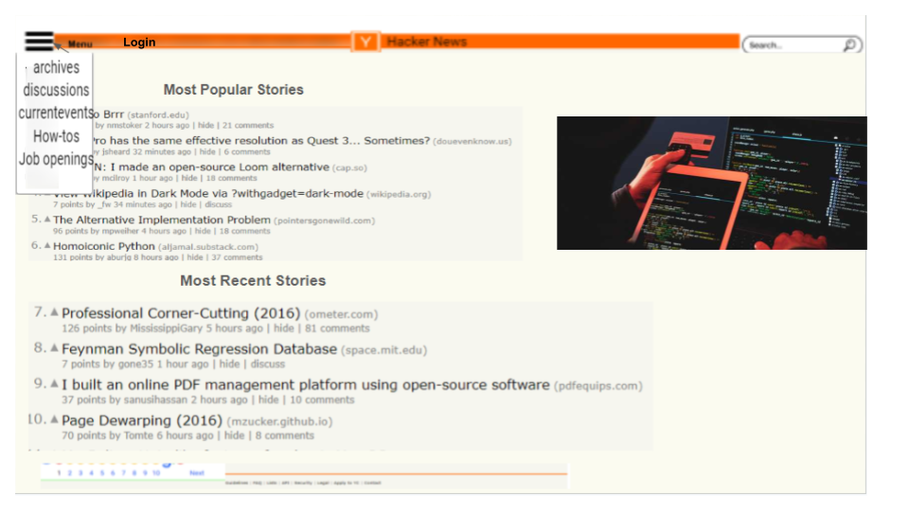
LOGIN
Notes:
HOMEPAGE

Slide 23
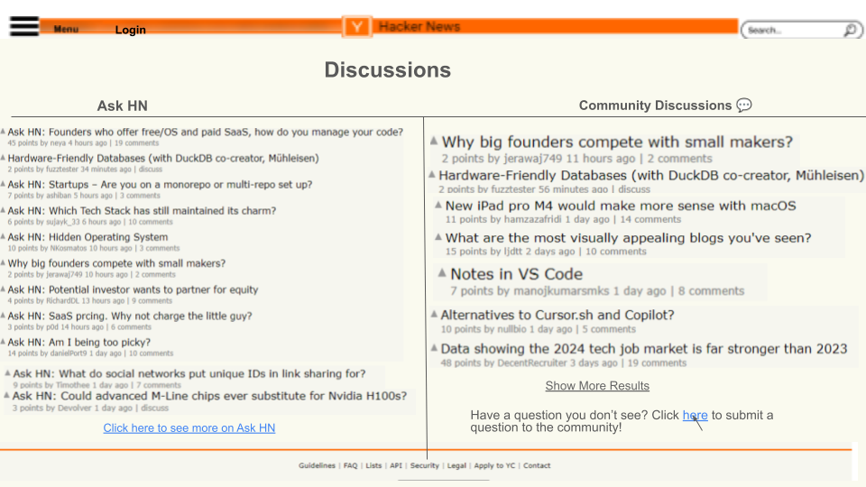
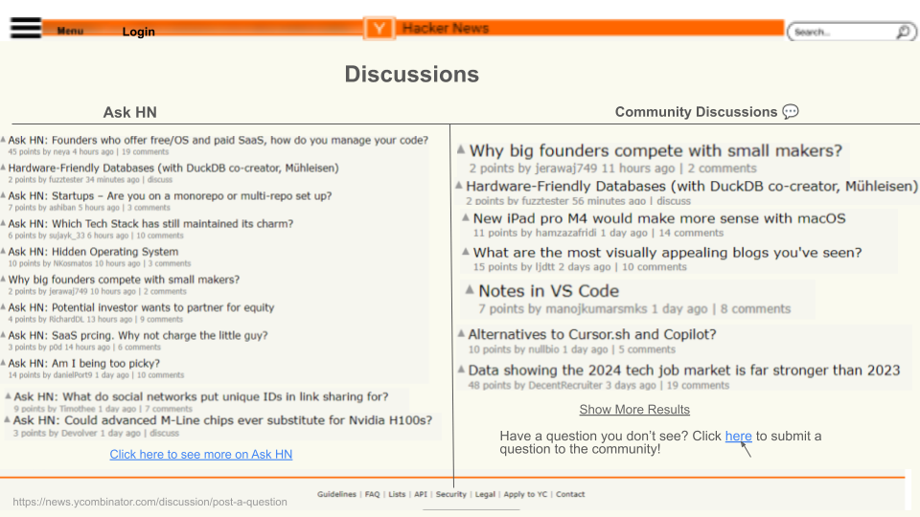
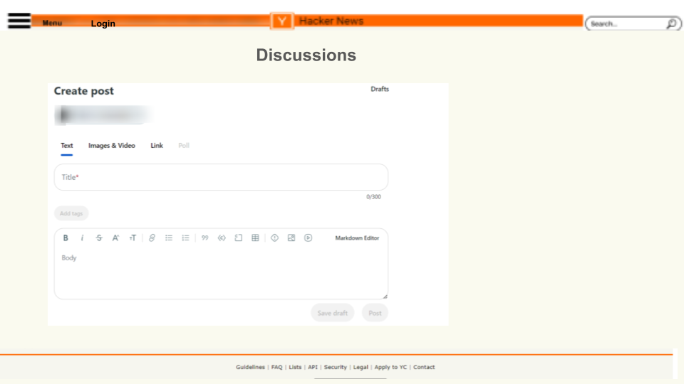
Notes:
Ask page

Slide 24
References
Hacker News. (n.d.). Retrieved May 09, 2024, from https://news.ycombinator.com/
Hamidi, F. (2024, Feb. 9). Week 2 – Goals of Interactive Design [Lecture]
Hamidi, F. (2024, Mar. 15). Week 5 – Models & Metaphors [Lecture]
Hamidi, F. (2024, Mar. 29). Week 6 – Information Processing [Lecture]
Hamidi, F. (2024, Apr. 5). Week 8 – Information Design [Lecture]
Mayenge, L. (2024, May. 12). IS 303 Final Project [Presentation]

